Slide 1
Group: 44
Comparative Analysis of Indian Railway
Network and European Railway Network
Submitted by:
Akash Kushwaha 2021514
Chaitanya Arora 2021033
Kashvi Panvanda 2022245

Slide 2
Problem Statement
Railway networks are critical transportation backbones that underpin economic activity, regional connectivity, and social mobility. However, their topologies and operational characteristics vary markedly between developing and developed regions. In this study, we perform a comparative network analysis of the Indian Railway Network (IRN)—a large, historically evolved, route-based system—and the Eastern European Railway Network (ERN)—modeled via spatial proximity.
Objective: Analyze and compare the Indian and Eastern European Railway Networks using graph-theoretic metrics.

Slide 3
Dataset Description: Indian Railway Network
Indian Railway Dataset:
Source: Indian Railway Train Time Table data. LINK - https://www.data.gov.in/resource/indian-railways-time-table-trains-available-reservation-01112017
Contents: Station names, train numbers, and ordered stop sequences.
Nodes: 62,142 stations
Edges: 3,429 proximity-based links (K-Nearest Neighbor approach)
Processing: Geocoding was performed to associate station names with coordinates. An edge list was constructed from sequential station pairs along train routes.

Slide 4
Dataset Description: European Railway Network
Eastern European Railway Dataset:
Source: European Railway Stations dataset, including station names and geographic coordinates. LINK - https://www.kaggle.com/datasets/headsortails/train-stations-in-europe?resource=download
Nodes: 62142 stations
Edges: 3429
Processing: Edges were inferred using a K-Nearest Neighbor (KNN) approach based on geographic proximity, since explicit route information was not available.

Slide 5
Related Work
Latora & Marchiori (2001): Introduced efficiency metrics for spatial transport networks, highlighting small-world traits.
Sen et al. (2003): Analyzed the Indian Railway network’s fractal and small-world properties, demonstrating hierarchical hub structures.
Barrat et al. (2004): Modeled weighted networks to capture traffic intensity and geographic constraints.
Past Comparative Studies have seldom contrasted a large developing‐world system (IRN) with a purely spatially inferred European system, leaving a gap in understanding how route history vs. geographic proximity shapes topology.

Slide 6
Computed Metrics
Metric | IRN | ERN | Inference
Nodes | 8 147 | 62 142 | ERN covers far more stations geographically, but IRN concentrates on a smaller set of high-traffic nodes.
Edges | 902 602 | 3 429 | IRN’s route-based model produces ∼260× more edges than ERN’s proximity model, leading to much denser connectivity.
Avg. in/out-degree | 110.79 | 0.06 | IRN is highly connected with many routes per station; ERN is extremely sparse, reflecting only nearest-neighbor links.
Avg. undirected degree | 122.85 | 0.11 | Even when symmetrized, ERN’s stations link to almost no neighbors, while IRN offers dozens of bidirectional connections on average.
Weakly connected components | 7 | 58 713 | IRN forms one giant reachable network; ERN’s directed graph is almost entirely disconnected except for few tiny chains.
Strongly connected components | 9 | 62 142 | IRN has extensive reciprocal routes forming strong components; ERN’s directed KNN links rarely return, yielding every node its own component.
Density | 0.0151 | 1.8 × 10⁻⁶ | IRN is ∼8 000× denser, reflecting overlapping train services vs. single-edge proximity links in ERN.
Avg. clustering coefficient | 0.7635 | 0.00006 | IRN exhibits extremely high local clustering (many overlapping routes), whereas ERN has virtually no triangles in its spatially inferred network.
Mean diameter | 2.86 | 52 | In the undirected view, IRN’s diameter is tiny—any two stations are <3 hops apart—versus ERN’s much larger diameter, requiring many hops across sparse links.
Avg. shortest-path length | 1.38 | 14.7 | IRN offers ultra-short paths via dense hub connectivity; ERN’s sparse proximity graph forces longer multi-hop journeys.
Degree assortativity (Pearson r) | +0.24 | +0.34 | Both networks are assortative, but ERN more so: high-degree nodes preferentially link to other high-degree nodes, reinforcing capital clusters.
Betweenness centralization | High | Moderate | IRN’s traffic is dominated by a few junctions; ERN spreads betweenness more evenly among its regional hubs.
Top motif Z-score | N/A (too dense) | ±1.57 | ERN shows one significantly overrepresented and one underrepresented triad, highlighting specific local loop patterns; IRN’s density makes motif detection infeasible.

Slide 7
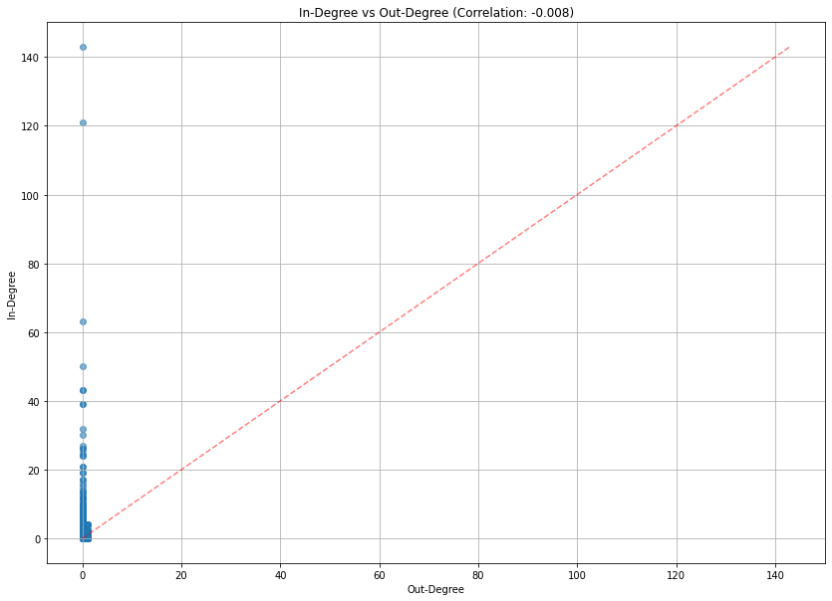
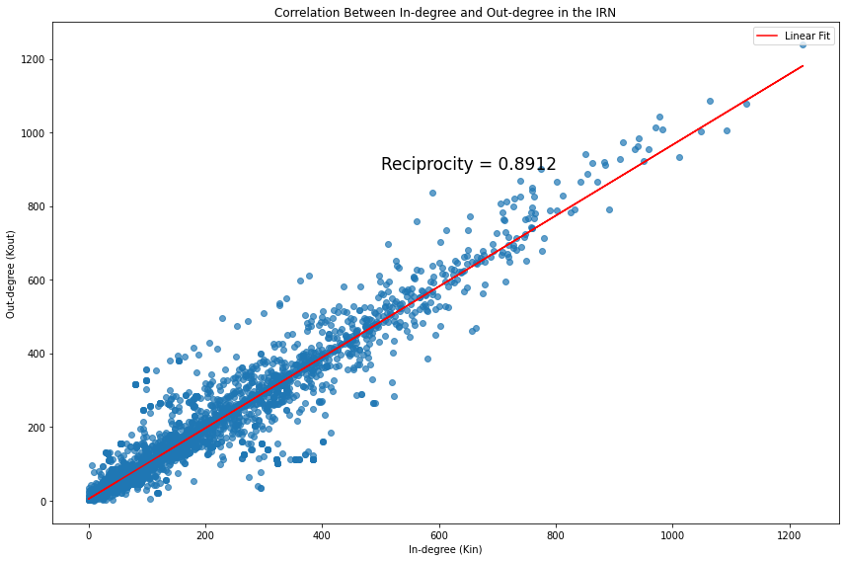
Visualizations
1. Correlation Analyses
Indian Railway
European Railway
The IRN shows strong reciprocity (0.8912), indicating bidirectional routes, unlike ERN, which has sparse in/out-degree correlation, suggesting more one-way or modular route structures with limited mutual connectivity.

Slide 8
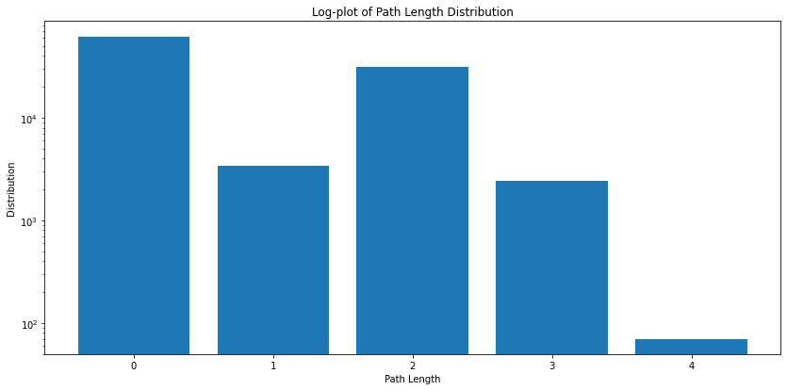
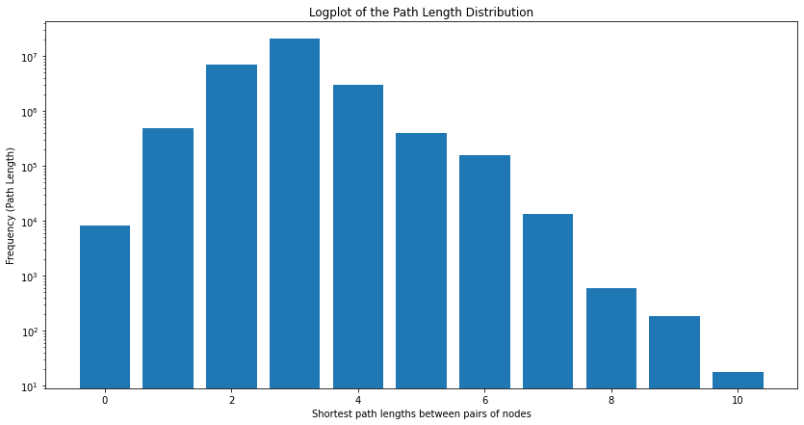
Visualizations
2. Path Length Distribution
v
European Railway
Indian Railway
IRN's higher mean path length (1.38) compared to ERN (1.23) highlights its broader geographical spread. While IRN supports longer routes, ERN shows tighter, more localized connectivity with uniformly shorter paths, ideal for regional transport.

Slide 9
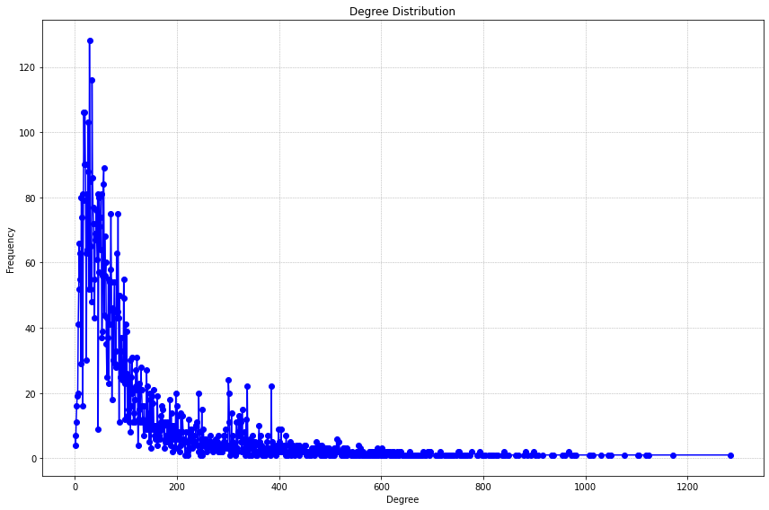
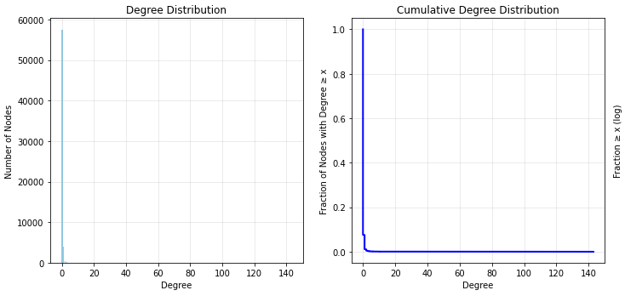
Visualizations
3. Degree Distribution
Indian Railway
European Railway
The Indian Railway Network shows a broad, heavy-tailed degree distribution, indicating hub stations, while the European Railway Network has a steeper drop, suggesting a more uniform, less centralized connectivity.

Slide 10
Motif Analysis
European Railway Network:
We are getting only 3 triads because the graph is very sparse (Average degree of undirected graph is 0.11), and hence only 1 Motif and 1 anti-motif are detected.
Indian Railway Network:
Not feasible computationally since the graph is highly connected and dense (Average degree for undirected: 122.85)
Type | Z-score | Original Count | Random Mean | Standard Deviation
0: Motif | 1.568929 | 7 | 5.4 | 1.019804
1: Anti-Motif | 1.568929 | 5 | 6.6 | 1.019804

Slide 11
Random Graph Models
Random Graph Baselines on (IRN):
IRN ≈ Scale-Free Network
Indicates hub-based efficiency (e.g., major junctions)
ERN:
Nodes: 62,142, Edges: 3,468
Density: 1.8 x 10^-6, Avg. Degree: 0.11
Disconnected — 58,674 components
Largest connected component: 7 nodes
Model | Clustering | Path Length ↓
Barabási–Albert | 0.0274 | 2.53
Erdős–Rényi | 0.0074 | 2.63

Slide 12
Results and Analysis
Clustering
IRN: Few triads — mostly linear routes
ERN: High local clustering — many 3-node loops
Assortativity
IRN: Disassortative → Hubs connect to small nodes
ERN: Assortative → Hubs link to hubs
Connectivity
IRN: Small-world, lattice-like: z
Clustering: 0.62, Avg. Path: 15, Diameter: 52
ERN: Sparse, tree-like:
Avg. Degree: 0.06, Avg. Path: 68, Diameter: 478
Hubs
IRN: Centralized — major hubs (NDLS, BZA) → critical points
ERN: Distributed — hubs share load with regional nodes
Takeaway:
IRN is centralized and efficient for long-haul travel; ERN is modular, robust, and supports local rerouting.

Slide 13
Conclusions & Cross-Learning Opportunities
Indian Railway → European Lessons
Increase Local Redundancy: Introduce short “cross-links” between parallel lines to form loops, reducing reliance on a handful of junctions.
Moderate Centralization: Redistribute traffic by developing secondary hubs, alleviating pressure on mega-junctions like New Delhi.
European Railway → Indian Lessons
Hierarchical Scheduling: Adopt clearer route hierarchies (e.g., express vs. local tracks) to improve end-to-end speed on long runs.
Adaptive KNN Routing: Use spatial-proximity analysis to identify underserved corridors for new track construction, filling geographic “holes.”
Mutual Strategies
Resilience via Motifs: Both networks can benefit from creating strategic 3-station loops to enhance rerouting options during service interruptions.
Data-Driven Hub Development: Leverage centrality and clustering metrics to prioritize station upgrades and capacity expansions where they yield the greatest network impact.

